Slide 1
MINI PROJECT
PRESENTATION

Slide 2
CLASS SUBJECT REMINDER APPLICATION
Delish kumar R Dikshit s

Slide 3
PROBLEM STATEMENT
Even if everything in our world is evolving, the timetable for classes is one of the things that hasn't undergone any changes. Yet, the majority of the personnel still uses a paper timetable. therefore, to save them from having to refer. Class Reminder is the name of the software we're making.

Slide 4
ABSTRACT
The tendency for people to forget things easily is one of the main issues facing them in
the current world.
Instead of seeing a physical time table, we are developing an application called an automated class reminder application that will automatically display the schedules when the user gives the time and data in our Application. This will prevent the user from having forgotten difficulties.
The user of this Application must enter the subject session times and the name of the subject. after providing the information that will be placed in the application's .
Our Application will send a reminder depending on the
information provided by the user in the application.

Slide 5


We'll notify the user in two different ways
Alarm : We will remind the topic name offline by establishing an alert. The notification will ring using a ringtone that the user has already given in our application.
E-mail: Users who utilize our application must provide their email id in order for us to deliver the subject data to their emails.

Slide 6
MAIN OBJECTIVE
With our programme, students and employees may quickly get schedule reminders.
They may quickly save referring time by using our programme rather of using and referring to a real timetable.
The primary motivation for the development of our programme is that many people nowadays easily forget things, thus it will serve as a reminder for everything.

Slide 7

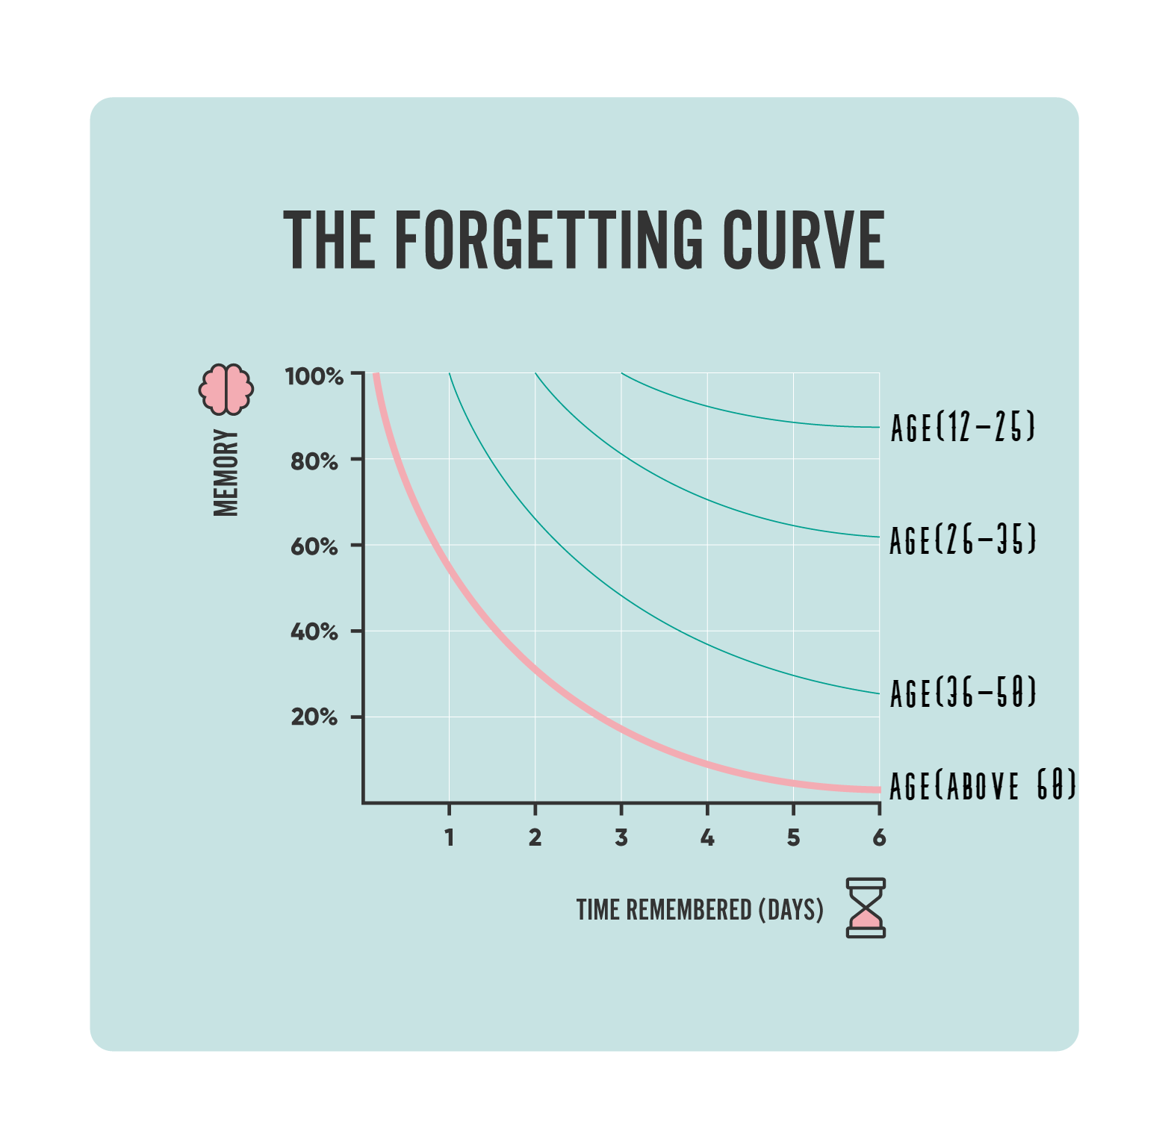
Average rate of human forgetfulness

Slide 8
ADVANTAGE
Other reminder applications often alert users by sounding the alarm. nonetheless, my programme will alert users by examining the data they have provided to our programme. The provided data was turned into audio using a voice assistant application, and the audio will serve as the alarm sound. Due to these qualities, people without sight may also utilise this programme.

Slide 9

IMPLEMENTATION
For the implementation of the class remainder application, we need four key Python modules.
Python's three modules are the smtplib module, the Playsound alarm module,the gTTs Voice assistant module and the dateandtime module. Each Python module has its own set of characteristics.
The “smptlib” module is responsible for sending the alert information through email.
The alarm module is the one that the user decides to have sound at the
time of alarm using “Playsound”, and the “dateandtime” module is the
one that the alarm has been configured to alert to.

Slide 10
Smtplib: smtplib is a Python module. The purpose of smtplib in the class remainder application is to transmit the output, which is the alert, to the user through email. The smtplib works as a carrier in transmitting the alarm to the user's email address.
Playsound: Playsound is the second module needed in Python to build the class Remining application. In the class remining application, the alarm module is also known as the playsound module. The function of playsound is to play the alarm sound that the user has designated to the correct date and day.
METHOD USED IN IMPLEMENT THE SOLUTION

Slide 11
gTTs: gTTS stands for Google Text-to-Speech. It is a Python library and CLI tool to interface with Google Translates text-to-speech API. It writes spoken mp3 data to a file, a file-like object (bytestring) for further audio manipulation, or stdout. It features flexible pre-processing and tokenizing
DateandTime: The last module utilized in Python for the implementation of the class remaining module is the date and time module. There are formats for using the date and time module, such as 12 hr and 24 hr forms. The module has a class name that includes both the date and time. The alarm sounds when the date and time are set, and it turns off when the user presses the key that has been assigned to silence the alarm.
METHOD USED IN IMPLEMENT THE SOLUTION

Slide 12
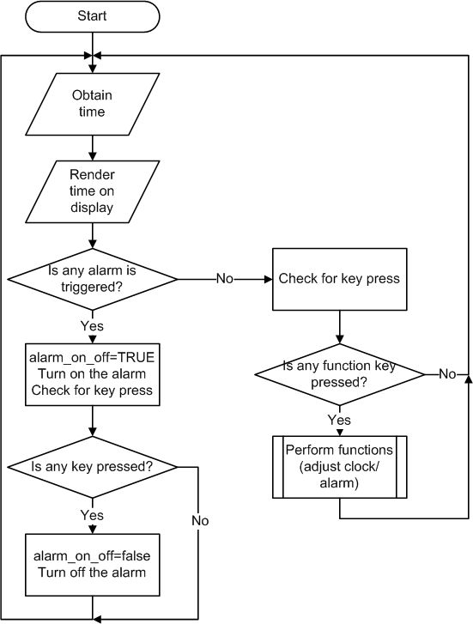
SYSTEM ARCHITECTURE

Slide 13
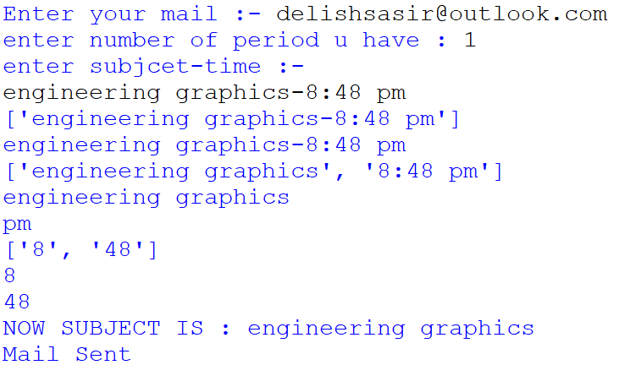
SAMPLE OUTPUT
PROVINDING INFO TO APPLICATION BY THE USER

Slide 14
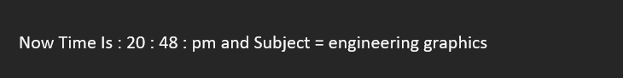
SAMPLE OUTPUT
REMIDING THE SUBJECT DATA THROUGH MAIL

Slide 15
EXISTING SYSTEMS
Google Calendar was introduced in 2006. Users have the ability to add and update events in Google Calendar. Events may be activated for reminders, with settings for type and timing. nonetheless, a significant negative is the requirement to create a reminder for each event. However, using my application, events can be scheduled for the same time slot and repeated each week.

Slide 16
FUTURE ENHANCEMENT
Future updates to our application will include a database. These databases are able to compile whole university timetables and notify users. Our application will demonstrate for more development like What subjects and units do the staff or teachers teach in previous classes

Slide 17
CONCLUSION
It is a ground-breaking product that will be extremely helpful for college and high school students as well as for teachers. I'm hoping that the educational system will change in the future so that everyone will learn in smart technology books, in which case our application will be quite helpful.

Slide 18
REFERENCES
Baddeley, A. D., & Wilson, B. A. (1994). When implicit learning fails: Amnesia and the problem of error elimination. Neuropsychologia, 32, 53 – 68. Baldwin, V. N. (2012).
Factors influencing the uptake of memory compensations following acquired brain injury.
Unpublished doctoral thesis. University of Birmingham, England. Baldwin, V. N., Powell, T., & Lorenc, L. (2011).
Factors influencing the uptake of memory compensations: A qualitative analysis. Neuropsychological Rehabilitation, 21, 484 – 501. Beck, A. T., Weissman, A., Lester, D., & Trexler, L. (1974).
The measurement of pessimism: The hopelessness scale. Journal of Consulting and Clinical Psychology, 42, 861 – 865. Bender Pape, T. L., Kim, J., & Weiner, B. (2002).
The shaping of individual meanings assigned to assistive technology: A review of personal factors. Disability and Rehabilitation, 24, 5–20. Cicerone, K. D., Dahlberg C., Malec, J. F., Langenbahn, D. M., Felicetti, T., Kneipp, S., ... Catanese, J. (2005).
Evidence-based cognitive rehabilitation: Updated review of the literature from 1998 through 2002.
Archives of Physical Medicine and Rehabilitation, 86, 1681 – 1692. Crawford, J., Smith, G., Maylor, E., Della Sala, S., & Logie, R. (2003).
The Prospective and Retrospective Memory Questionnaire (PRMQ): Normative data and latent structure in a large non-clinical sample.
Memory, 11, 261 – 275. Culley, C., & Evans, J. J. (2010). SMS text messaging as a means of increasing recall of therapy goals in brain injury rehabilitation: A single-blind within-subjects trial. Neuropsychological Rehabilitation, 20, 103– 119.

